Slide 1





HackOrbit 2025
404 Found Us

Slide 2


Theme And Problem Statement
Theme: Healthcare
Problem Statement: Existing healthcare workflows lack integration and real-time access to patient data, leading to inefficiencies and errors. We aim to build a comprehensive E-Health Management System that digitizes and centralizes healthcare services for better accessibility, accuracy, and coordination.

Slide 3

PROPOSED SOLUTION
Centralized Electronic Health Records (EHR)
Role-Based Access Control
Real-Time Data Synchronization
Automated Appointment Scheduling
Integrated Telemedicine Services
Digital Prescription Management
Billing and Payment Integration
Health Analytics Dashboard

Slide 4
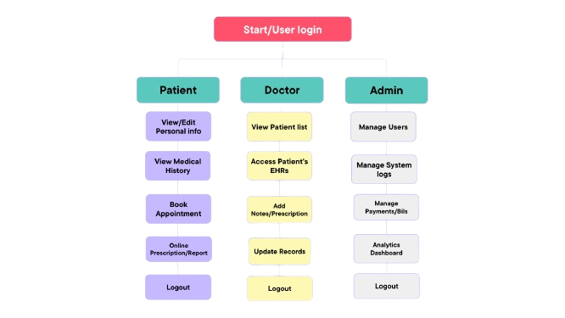
FLOWCHART / DIAGRAM

Slide 5

FLOWCHART / DIAGRAM
The system begins with user login and proceeds based on role detection. Each role follows a distinct flow:
🟦 Patient Flow
View/Edit Personal Information
Book Appointments
Access Medical History and Reports
Video Consultation & Online Prescription
Logout
🟩 Doctor Flow
View Assigned Patients
Access and Update EHRs
Add Notes & Prescriptions
Conduct Consultations
Logout
🟧 Admin Flow
Manage User Accounts
Monitor System Logs
Handle Billing and Payments
Access Analytics Dashboard
Logout
🔁 The system ensures secure login and logout for every role, maintaining data privacy and smooth workflow.

Slide 6
FEATURES AND NOVELTY
✅ Key Features
Role-based access for security
EHR integration for centralized data
Video consultations and online prescriptions
Admin dashboard with billing and system analytics
Appointment booking and patient profile management
✨ What’s Unique
Unified platform for 3 roles
Combines EHR + Telemedicine + Analytics
Real-time record updates
Future-ready design for AI and IoT integration

Slide 7
DRAWBACK AND SHOWSTOPPERS
⚠️ Drawbacks
Needs stable internet connectivity
Not suitable for remote/rural areas
Lacks AI-powered diagnostics (for now)
Traditional doctors may resist adoption
🚧 Showstoppers
Data privacy & regulatory compliance (HIPAA, etc.)
Difficult integration with outdated hospital systems
Downtime may disrupt critical healthcare
User onboarding & training challenges

Slide 8
404 Found Us
Name | Email | Phone number
Yatharth Gupta | guptayatharth353@gmail.com | 7999117324
Divyansh Rajput | divyanshrajput91565@gmail.com | 8223052405
Raghav Goyal | goyalraghav853@gmail.com | 8223052405
Himanshu Ranglani | himanshuranglani29@gmail.com | 9827490250

Slide 9
Thank you

